Slide 1
Medical Image Processing
Liu Xin

Slide 2
Motivation
1. The difference between medical images and natural images
2. Really understand the semantic information of the actual response of each medical image
3. Why Unet performs well on medical images?

Slide 3
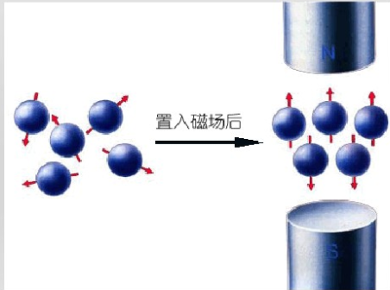
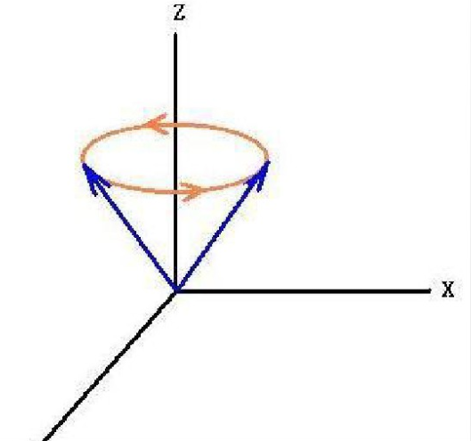
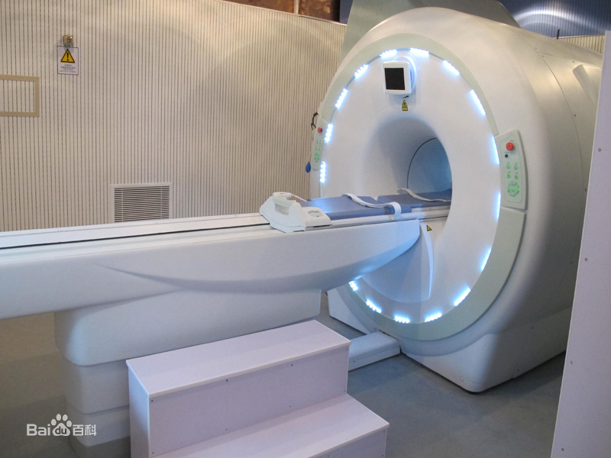
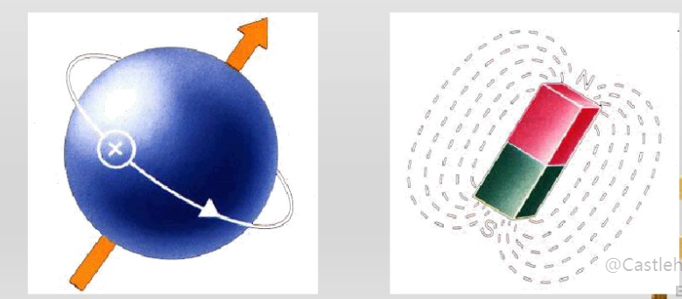
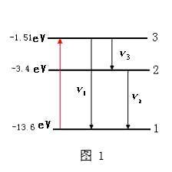
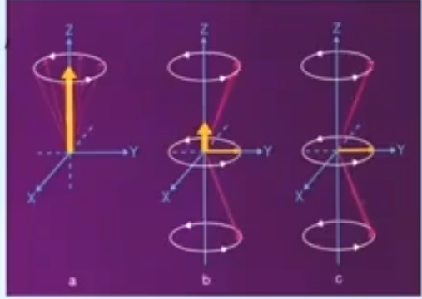
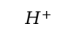
MRI（Magnetic Resonance Imaging）
$$H^{+}$$
B
RF
Resonance
energy level transition
longitudinal relaxation time
Stop RF
T1
组织间弛豫时间上的差别，是磁共振成像的成像基础
transverse relaxation time
T2
relaxationprocess

Slide 4
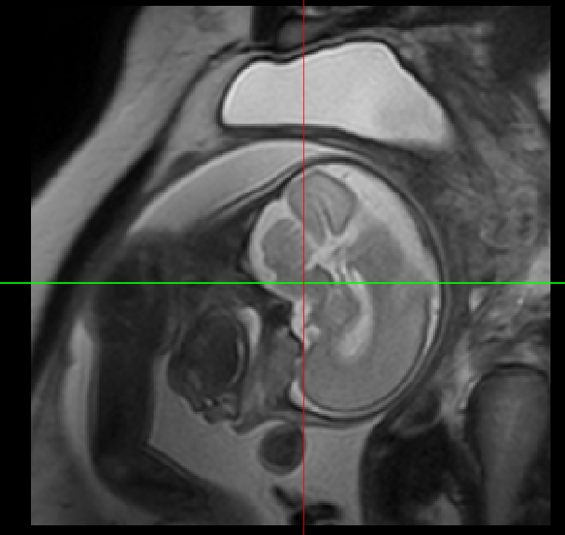
组 织 | T1 | T2
胼胝体 | 380 | 80
桥 脑 | 445 | 75
延 髓 | 475 | 100
小 脑 | 585 | 90
大 脑 | 600 | 100
脑脊液 | 1155 | 145
头 皮 | 235 | 60
骨 髓 | 320 | 80
T1（T1weighted image，T1WI），反映组织间T1的差别，常用于看解剖结构。
T2（T2weighted image，T2WI），反映组织间T2的差别，常用于看组织病变。
T1 像和T2像的区分：水在T1 像中是低信号（呈黑色），在T2 像中是高信号（呈白色）

Slide 5
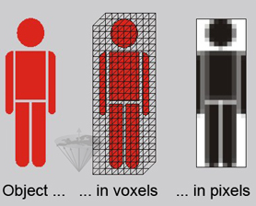
MRI
颅脑，脊髓，心脏大血管，关节骨骼、软组织和盆腔。软组织和解剖结构显示清晰；
中枢神经系统、膀胱、直肠、子宫、阴道、关节、肌肉等检查优于CT。
检测脑内血肿、脑外血肿、脑肿瘤、颅内动脉瘤、动静脉血管畸形、脑缺血、椎管内肿瘤、脊髓空洞症和脊髓积水等颅脑常见疾病非常有效。
腰椎椎间盘后突、原发性肝癌等疾病的诊断非常有效。
DataSets: [MICCAI_BraTS](https://academictorrents.com/details/a9e2741587d42ef6139aa474a95858a17952b3a5/tech)
[Kaggle MRI](https://www.kaggle.com/datasets?search=MRI)

Slide 6
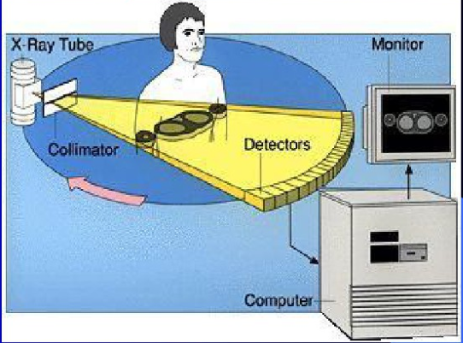
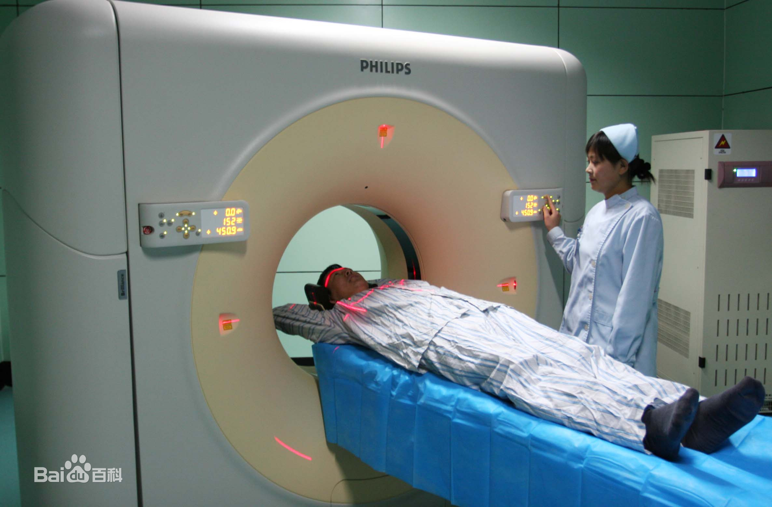
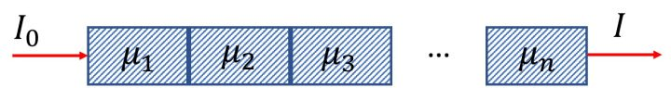
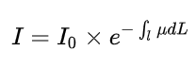
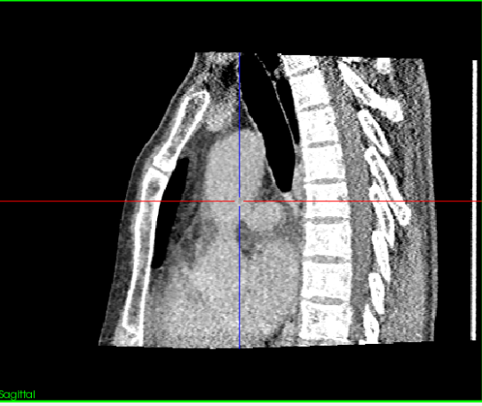
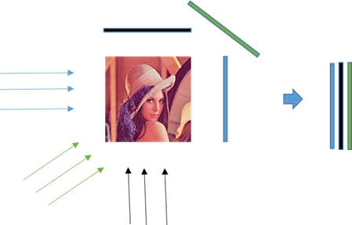
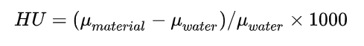
CT（Computed Tomography）
iRadon Transform
Radon Transform

Slide 7
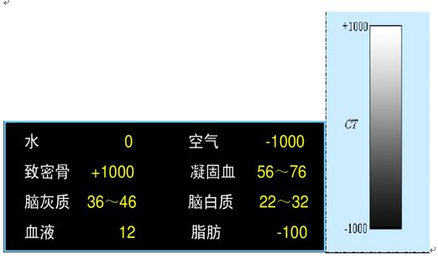
CT datasets：
NIHCC:https://nihcc.box.com/v/DeepLesion
RIDER Lung CT Dataset:https://hyper.ai/datasets/5633

Slide 8
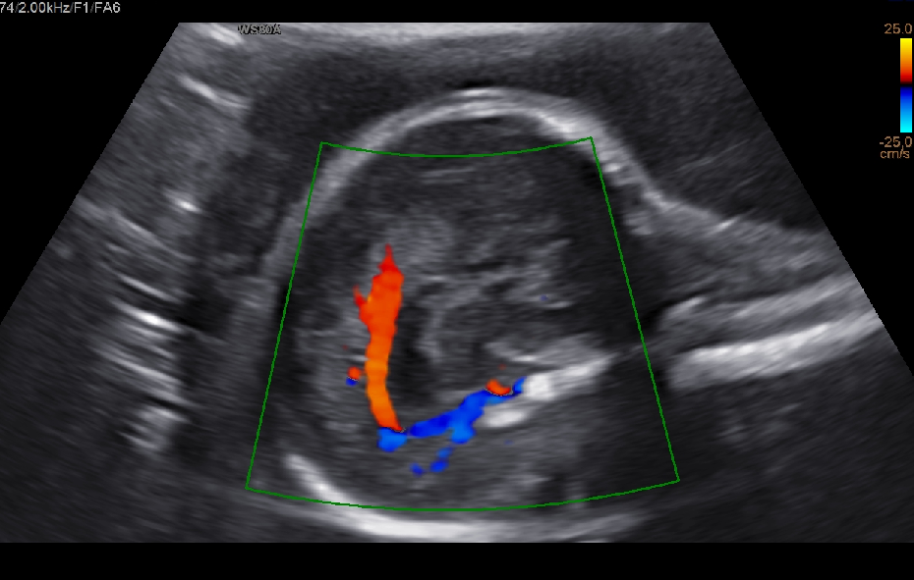
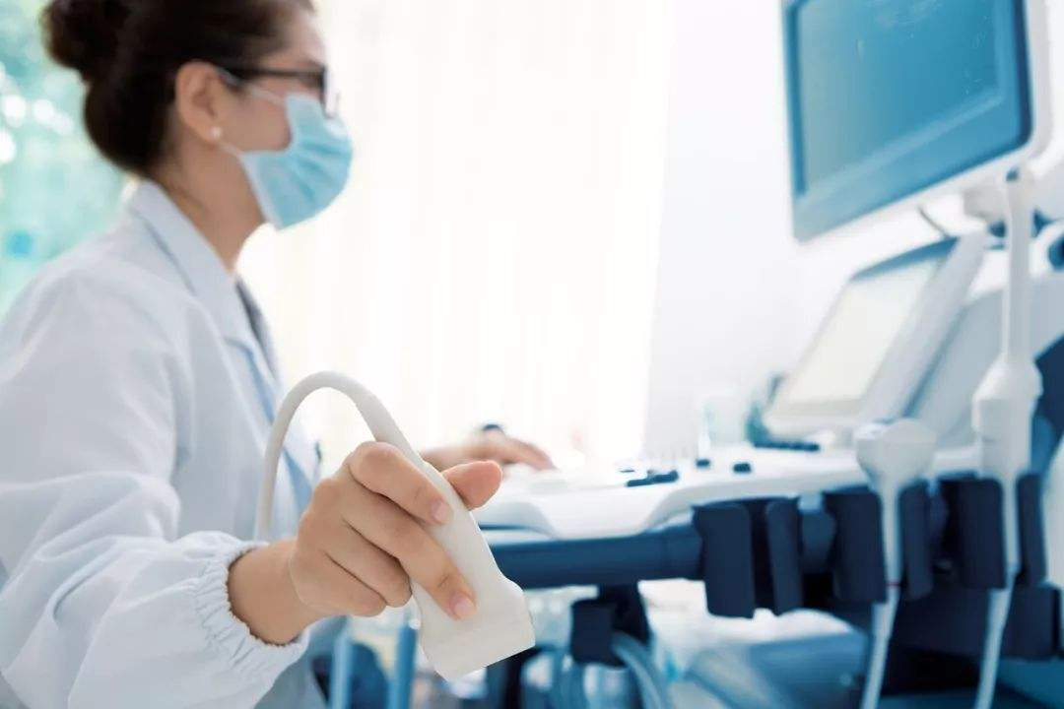
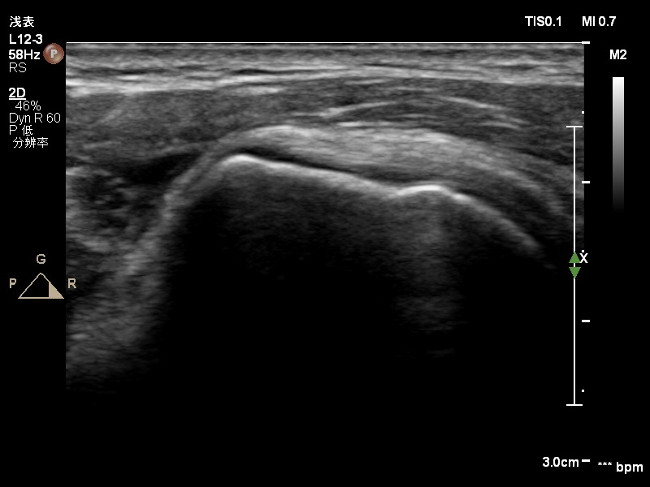
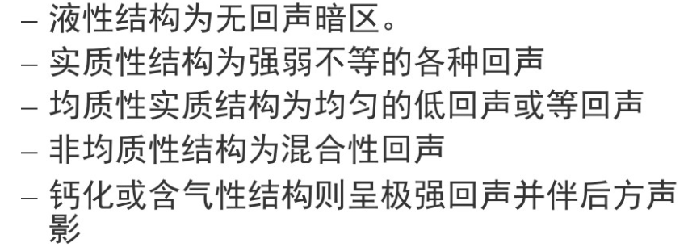
Ultrasound
The type of ultrasound：
Transverse wave
2.5~10 MHz

Slide 9
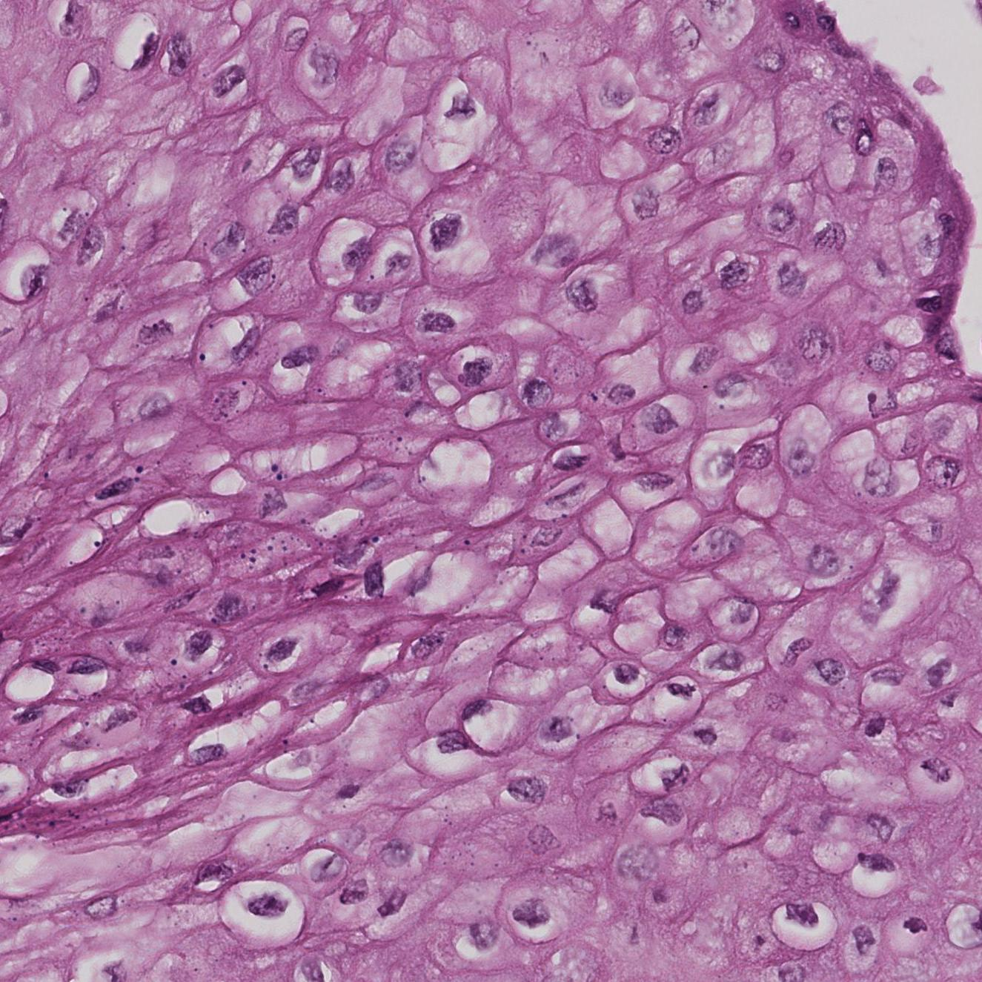
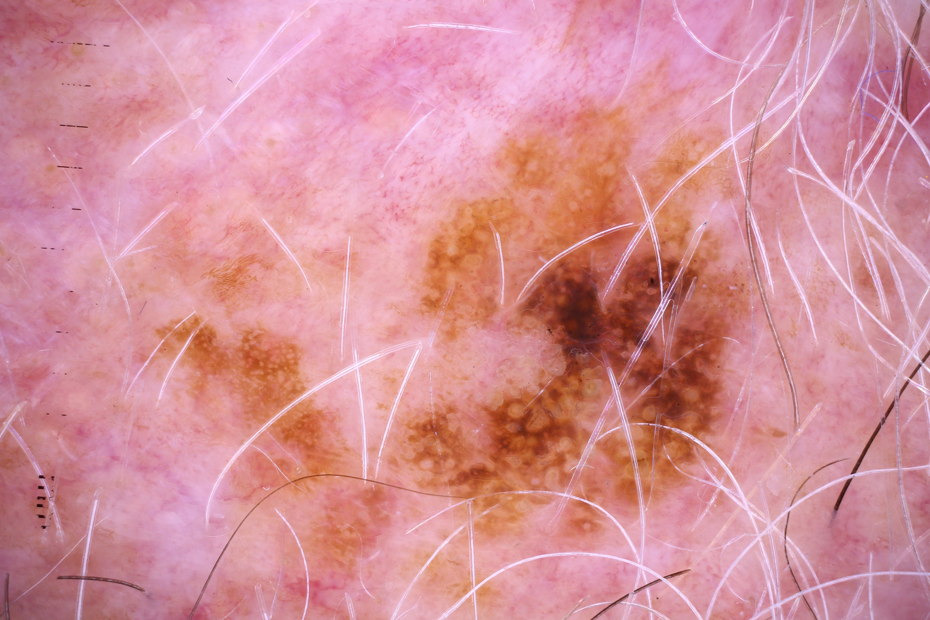
Pathological image

Slide 10
The difference between medical images and natural images
Imaging principle
Intrinsic characteristics
Modal
data volume, marked cost
Overly subjective

Slide 11
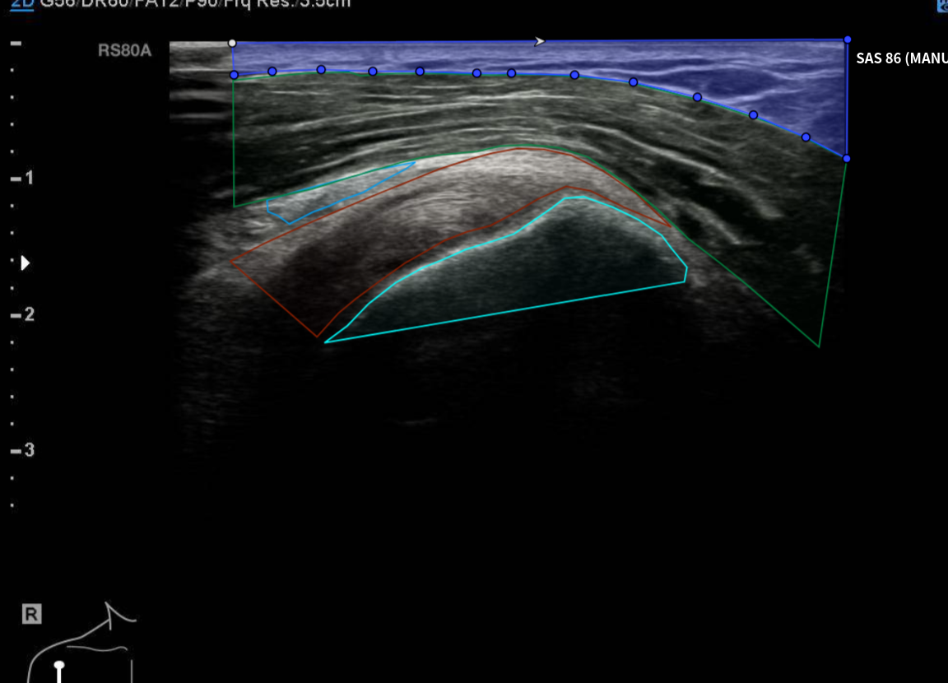
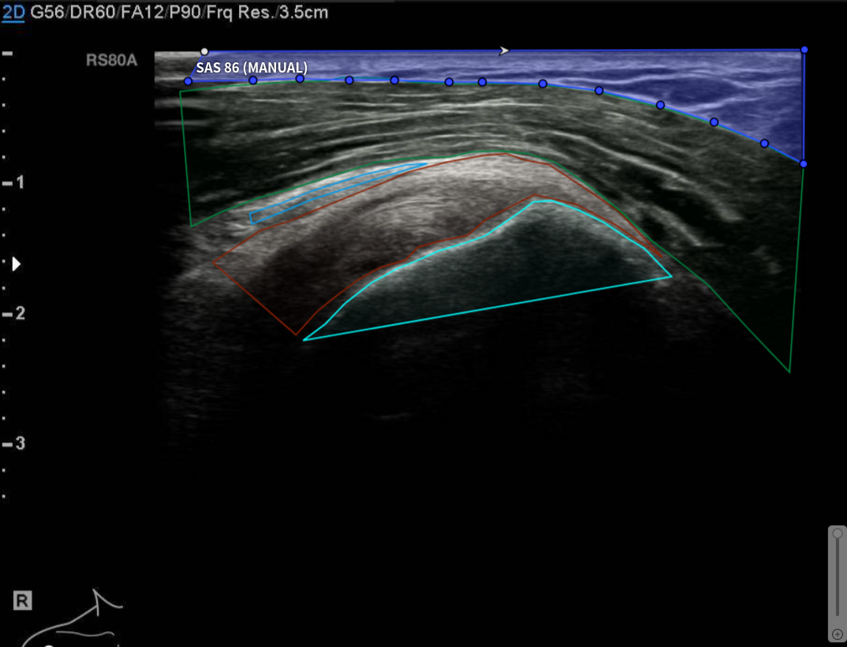
The difference between medical images and natural images

Slide 12
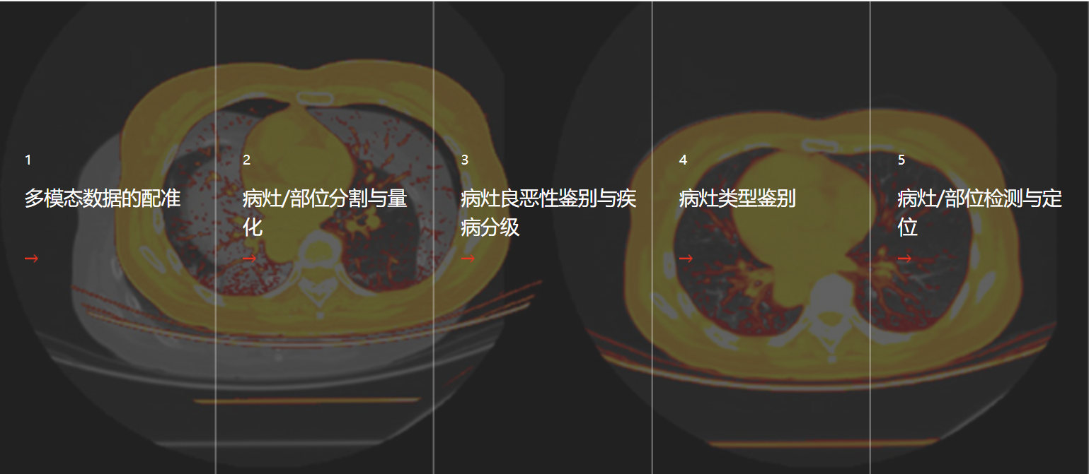

Slide 13
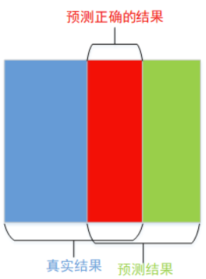
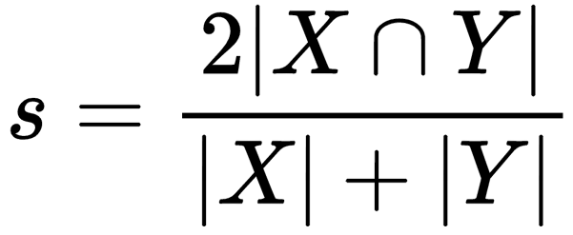
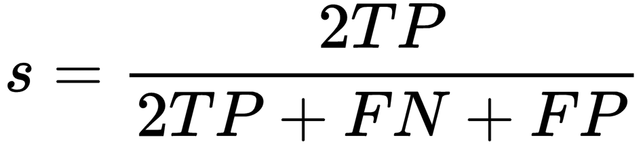
Medical image Segmentation
What need we segment?
Lesion: A lesion is any damage or abnormal change in the tissue of an organism, usually caused by disease or trauma.
Organ , Tissue
Segmentation Target?
Dice
mIou
PA
mPA
…

Slide 14
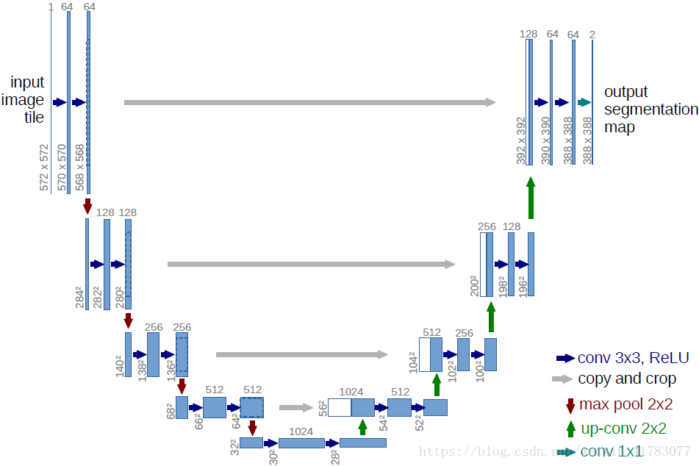
Medical image Segmentation
Why Unet performs well on medical images?
Network magnitude
Network structure

Slide 15
Medical image Segmentation
组 织 | T1 | T2
胼胝体 | 380 | 80
桥 脑 | 445 | 75
延 髓 | 475 | 100
小 脑 | 585 | 90
大 脑 | 600 | 100
脑脊液 | 1155 | 145
头 皮 | 235 | 60
骨 髓 | 320 | 80
对于医学图像而言，数据较少，但是其灰度信息非常丰富，以CT图像为例，CT图像的动态范围非常的广，图像的每个像素点，都代表了人体那块区域的CT值的平均值，而CT值就是对组织类型的一种映射，Unet对浅层特征的利用简单而直接，并且保留了多层，这对CT图像的信息利用是非常直接的，而对于自然图像而言，小面积的RGB值不具备密集的语义信息，需要大量的卷积提取出我们应该关注的信息，比如人的鼻子，眼睛，嘴巴等，丢弃其余冗余信息。

Slide 16
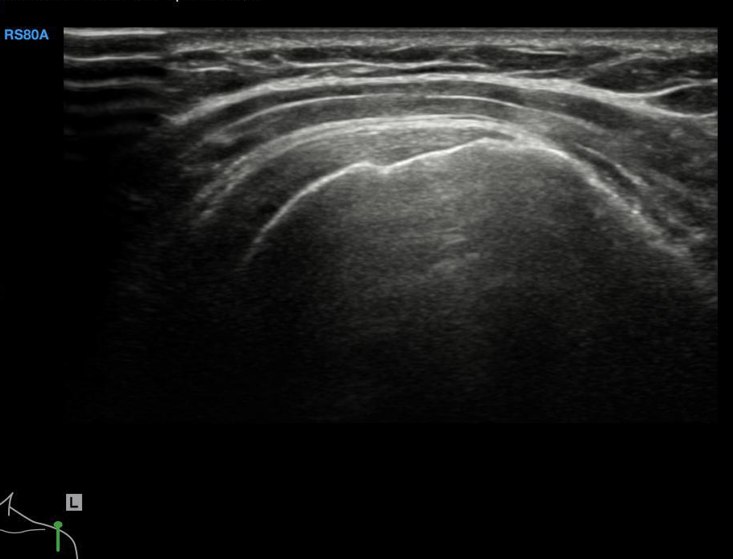
Medical image Segmentation

Slide 17
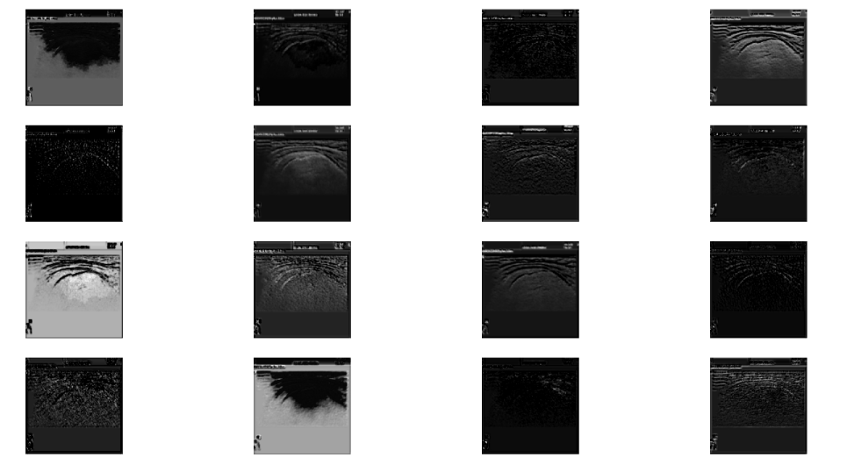
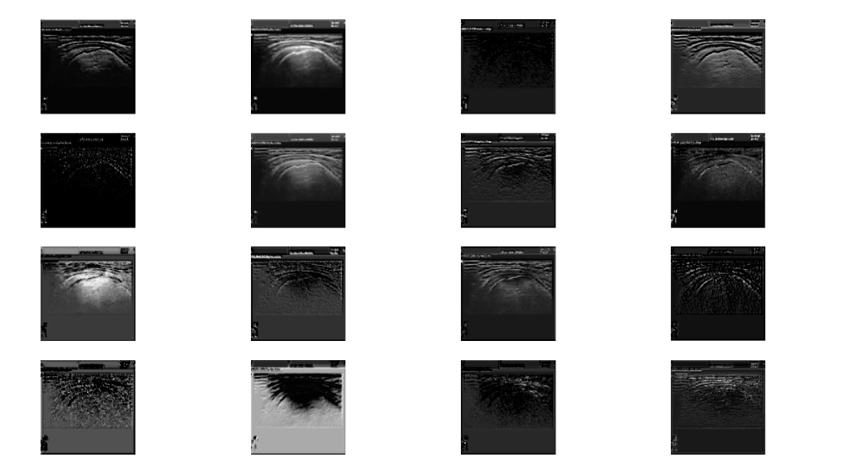
Medical image Segmentation
Unet
Deeplab
low feature

Slide 18
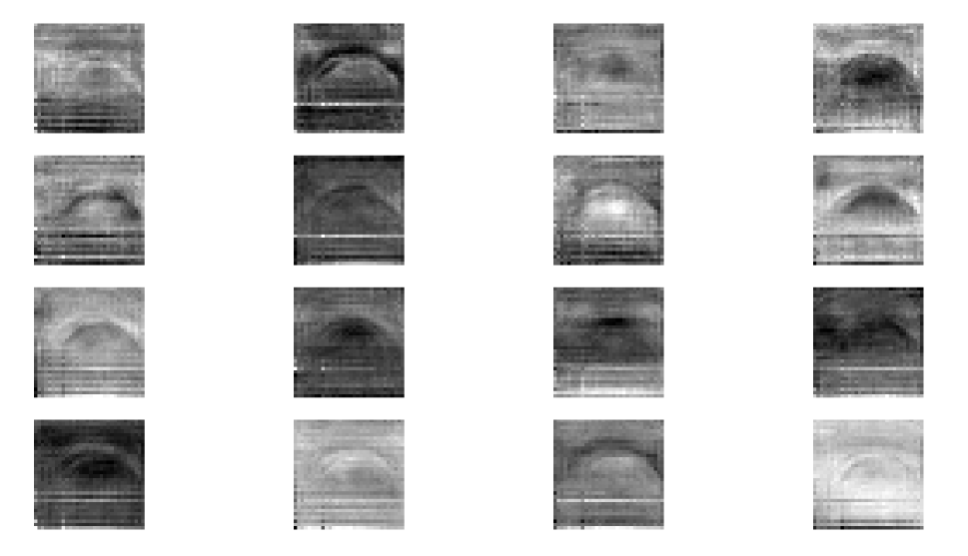
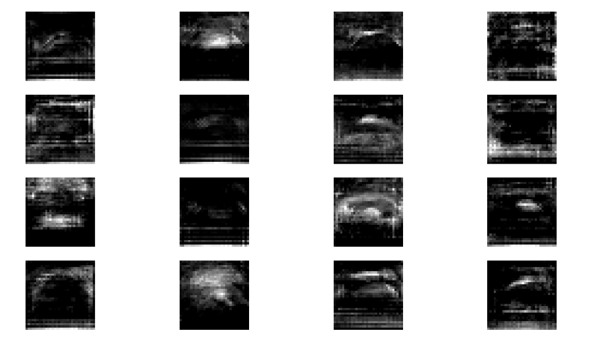
Medical image Segmentation

Slide 19
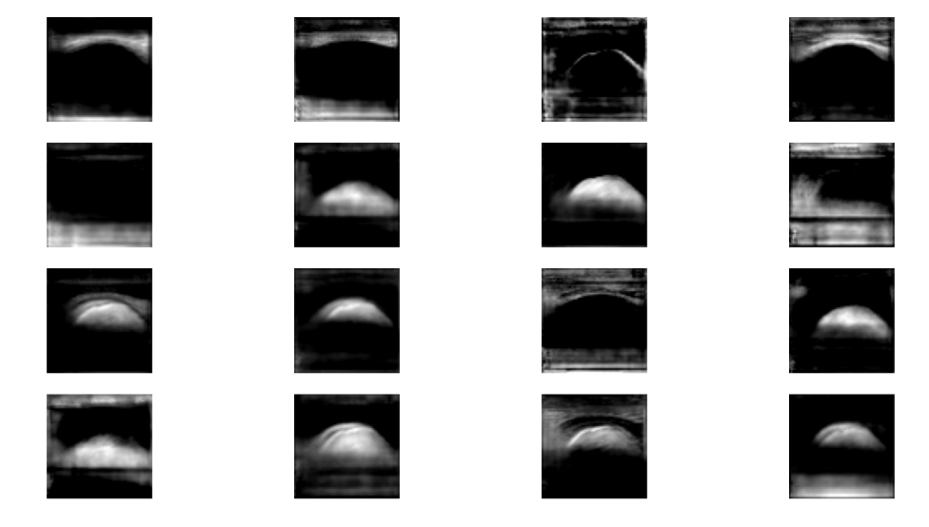
Medical image Segmentation

Slide 20
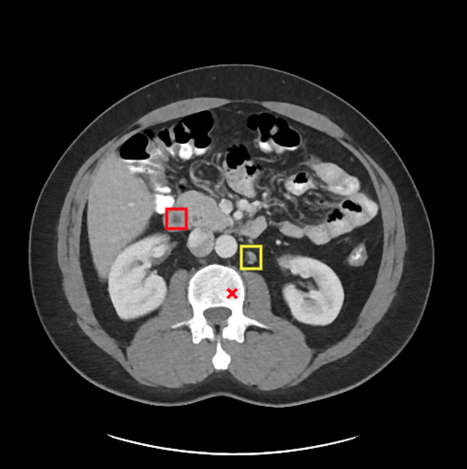
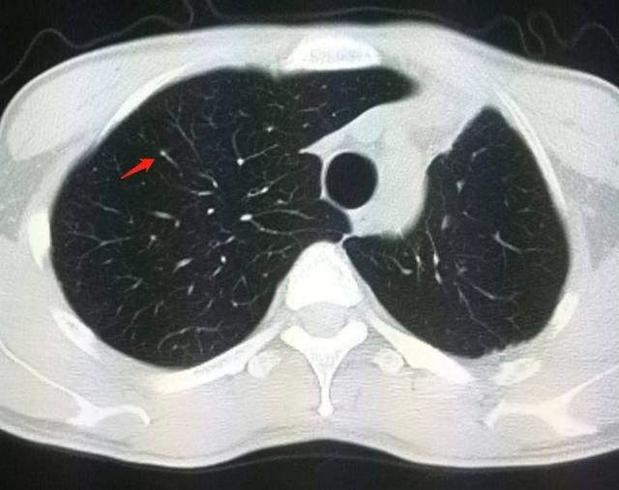
Medical image Detection(CAD)
Difficulties:
1. The size, shape, and position of the target (such as pulmonary tuberculosis) vary greatly;
2. The appearance of the target and the non-target is small;

Slide 21
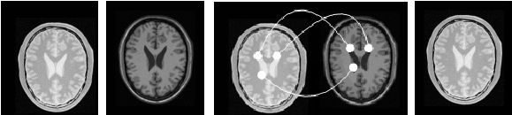
Medical Image Registration and Fusion

Slide 22
THANK YOU

